Slide 1
Solar thermal (hot water)
PowerPoint presentation
Unit 301: Understand the fundamental principles and requirements of environmental technology systems

Slide 2

What is renewable energy?
Main sources of renewable energy for the home are:
energy from sunlight
heat from the earth, the air or water sources
plants grown for fuel (biomass or biofuels)
waste
the movement of water (known as hydro) and wind.

Slide 3

Why use renewables?
making use of secure, local resources
reducing the dependence on non-renewable energy
helping to keep the air clean
helping to reduce the production of carbon dioxide and other greenhouse gases
creating new jobs in renewable energy industries
saving and even earning money.

Slide 4
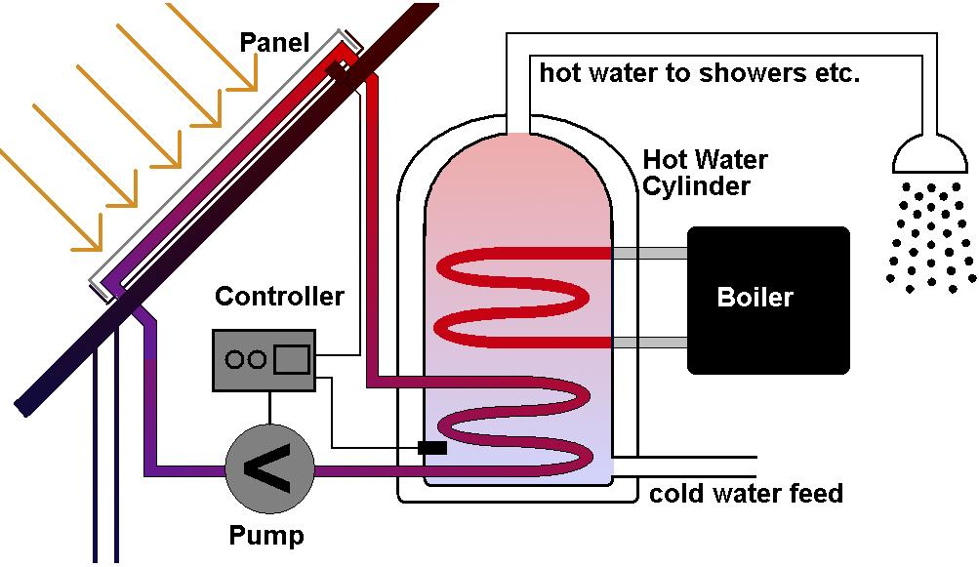
Solar thermal (hot water)
Solar thermal (hot water) is a renewable energy system for generating domestic hot water using solar panels (known as ‘collectors’) fitted at an optimal angle on a south‑facing roof or other suitable surface.

Slide 5
Solar thermal (hot water)
Installation location
Is there a suitable place for the panels?
Face between south east and south west at an appropriate angle.
If fitting them to a roof, then a check will need to be made to ensure that it can support the panels' weight.
Is there anything that will substantially shade the panels.

Slide 6
Solar thermal (hot water)
Planning requirements
Classed as ‘permitted development’ provided:
panel coverage less than 9m²
panels must not extend beyond the ridgeline
panels must not project more than 200mm from the roof or wall surface
not fixed to a listed building
not fixed to a building in a conservation area
not fixed to a building in a World Heritage Area
not fixed to a building close to a monument.

Slide 7
Solar thermal (hot water)
Building Regulations requirements
In most cases it will be necessary to give notification of the proposed works to the Council under the Building Regulations.

Slide 8
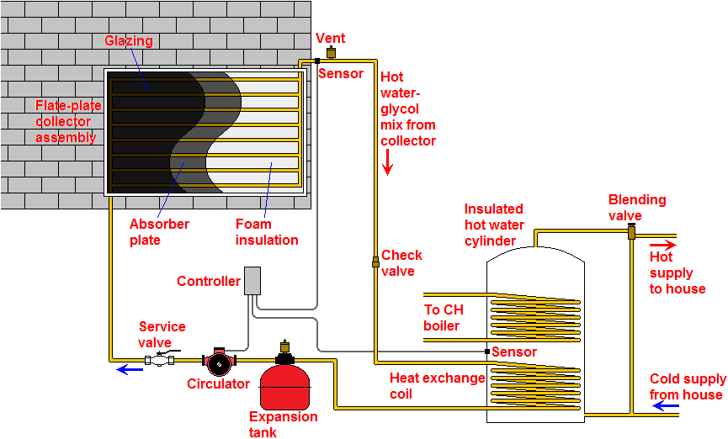
Solar thermal (hot water)

Slide 9
Solar thermal (hot water)
Advantages of solar thermal (hot water)
Cut carbon footprint
Cut bills
Hot water all year round.

Slide 10
Solar thermal (hot water)
Disadvantages of solar thermal (hot water)
Only available during daytime
Subject to the effects of climatic changes
Dependant on geographical location
Energy conversion rates or efficiencies are low compared to other energy sources
High capital cost.

Slide 11
Any questions?

